Slide 1

Community Awareness Plan: Supporting the Well-being of Cancer Patients
………………………………………………..

Slide 2


Slide 3
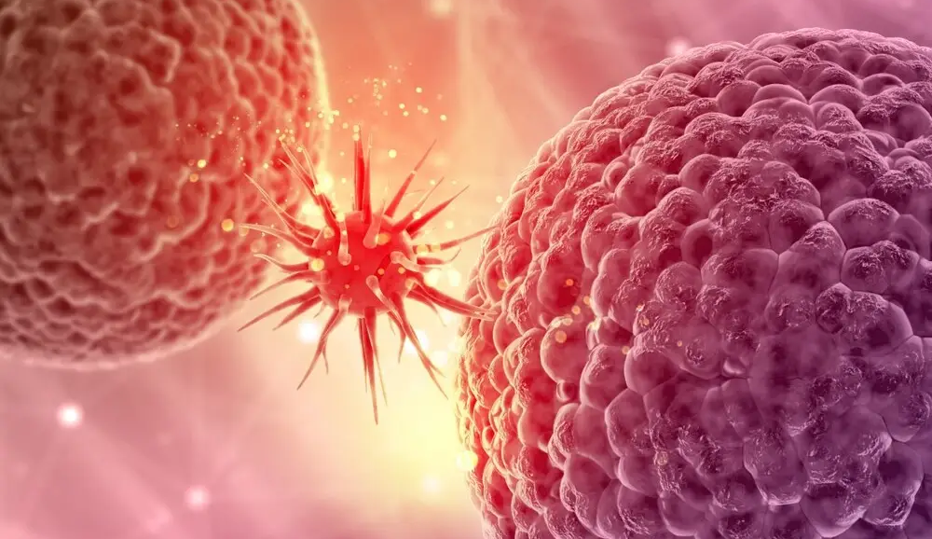
INTRODUCTION
Cancer is a serious illness that affects not just the body, but also the mind and emotions of the person who has it. Many people in our community are battling cancer and need support. This plan is about spreading awareness and helping cancer patients feel seen, supported, and cared for.

Slide 4


Slide 5
Teach people about cancer and the importance of early detection. . Encourage the community to be kind, helpful, and informed.
OBJECTIVES AND GOALS
Help cancer patients and their families feel supported.
Share information about local help and resources.

Slide 6


Slide 7

WHO WE WANT TO REACH
Everyone in the community (kids, adults, seniors)
People with cancer and their families
Doctors and nurses
Schools and teachers
Local businesses
Religious groups

Slide 8


Slide 9

MAIN MESSAGES

Slide 10

MAIN MESSAGES
Cancer patients need emotional and social support, not just medical help
Early checkups can save lives.
There are many ways to help—even small acts matter.
You don’t have to be a doctor to make a difference

Slide 11
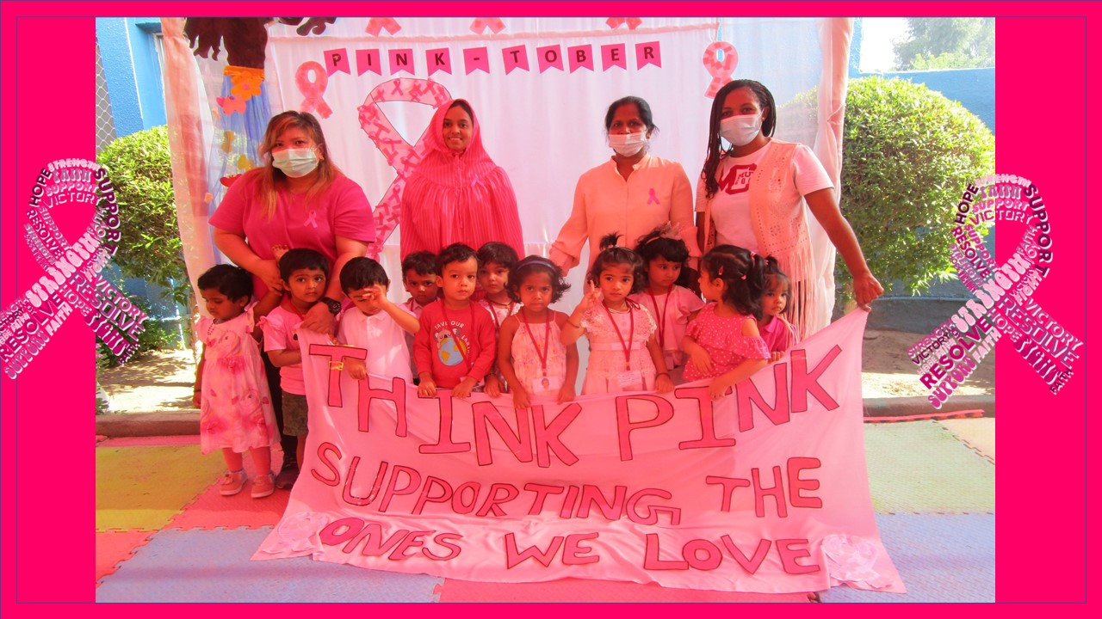
ACTIVITIES AND EVENTS

Slide 12

EDUCATIONAL EVENTS
Host community seminars, webinars, and Q&A sessions with oncologists and survivors.
1
Distribute brochures and flyers in public places (hospitals, clinics, malls, schools).
2
Run social media campaigns highlighting facts, patient stories, and support tips.
3

Slide 13
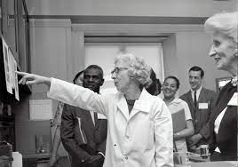
Education and Information Dissemination
Host community seminars, webinars, and Q&A sessions with oncologists and survivors.
1
Distribute brochures and flyers in public places (hospitals, clinics, malls, schools).
2
Run social media campaigns highlighting facts, patient stories, and support tips.
3

Slide 14

Outreach and Engagement
Partner with local NGOs and hospitals to conduct awareness drives.
Organize awareness walks, runs, or fundraising events.
Host support group meetings for patients and caregivers.

Slide 15

Resource Mobilization
Launch a local directory of cancer support services (transport, nutrition, counseling).
Develop a volunteer program to assist with errands, transport, or companionship.
Advocate for workplace policies that support cancer patients and caregivers.

Slide 16
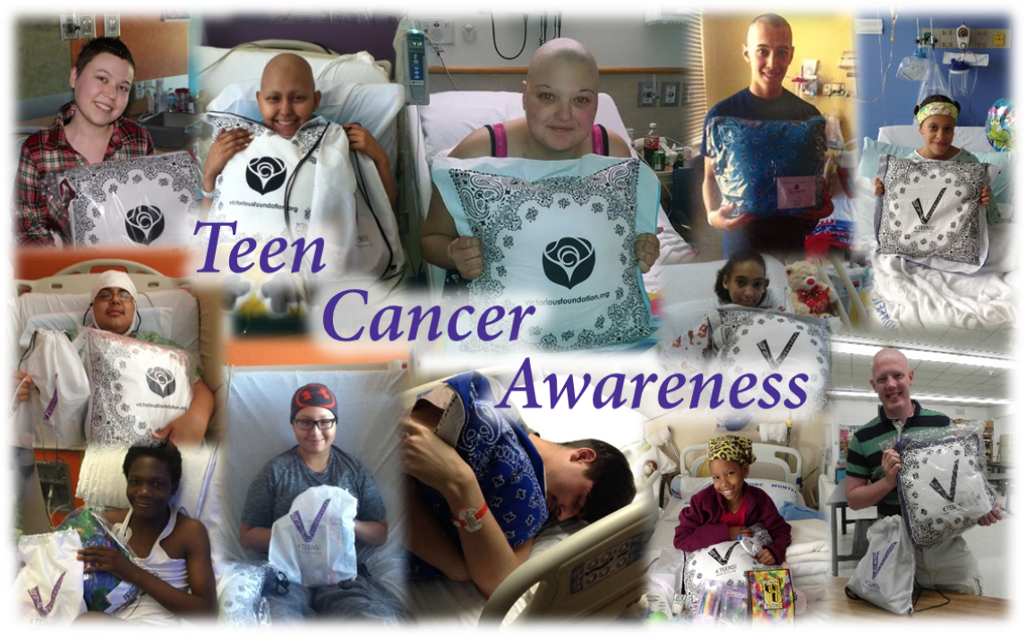
School and Youth Engagement
Conduct age-appropriate cancer awareness programs in schools.
Involve youth in volunteering and social media advocacy.

Slide 17
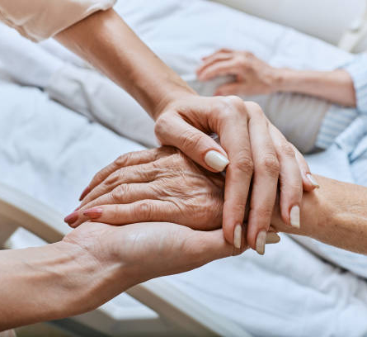
Cultural and Faith-Based Engagement
Work with churches, mosques, temples, etc., to share awareness messages.
Offer spiritual support programs for patients dealing with end-of-life issues.

Slide 18
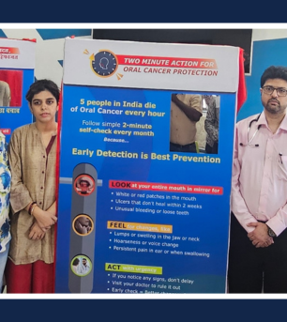
Communication Channels
Social media (Facebook, Instagram, Twitter, TikTok)
Local radio and TV
Community newsletters
Posters and banners
Community meetings and religious gatherings

Slide 19
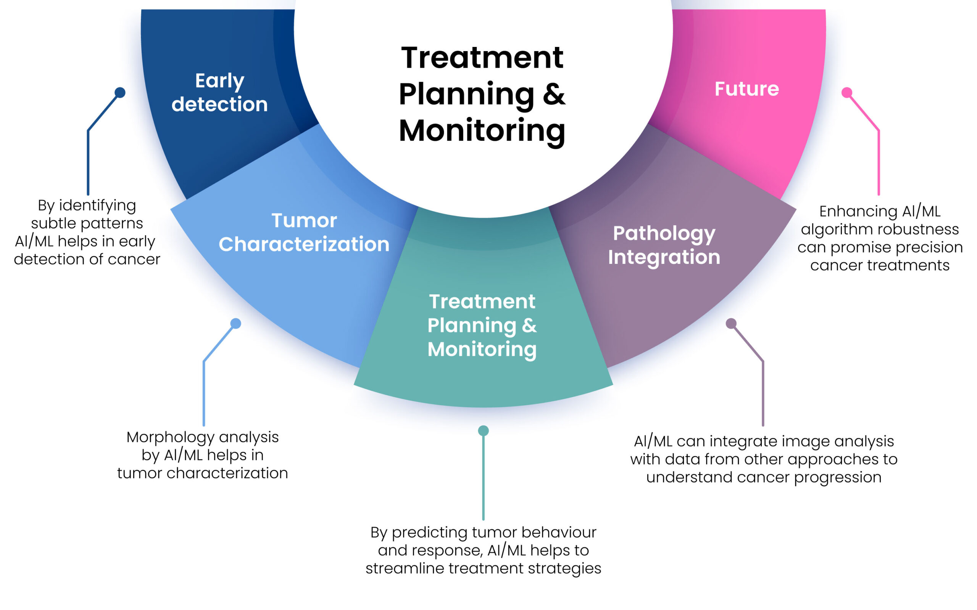
Monitoring and Evaluation
Track attendance at events and engagement online.
Collect feedback from participants and patients.
Survey awareness levels before and after campaigns.
Adjust strategies based on impact and feedback.

Slide 20

Timeline
Month 1–2: Planning, partnerships, and resource gathering
Month 3–6: Execution of events, media campaigns, outreach
Month 7–8: Monitoring and adjustment
Month 9–12: Evaluation and reporting

Slide 21

Budget Considerations
Printing and materials
Event logistics (venue, refreshments)
Speaker honorariums
Media and advertising
Volunteer coordination

Slide 22
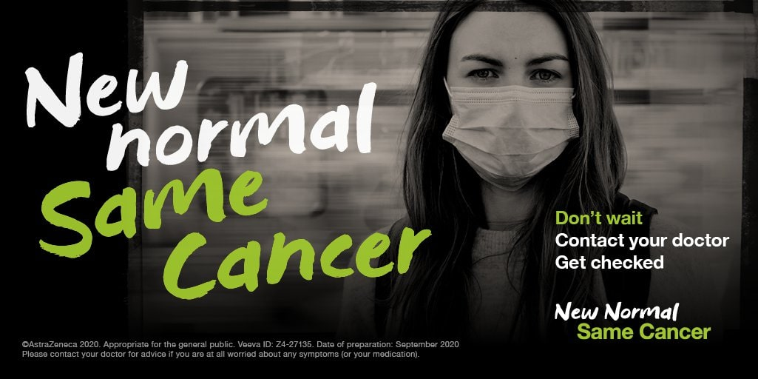

Slide 23

Conclusion
This plan shows that anyone—even students—can help make a difference in the lives of cancer patients. By spreading awareness, showing support, and working together, we can create a community where no one feels alone in their fight against cancer.

Slide 24


